Slide 1
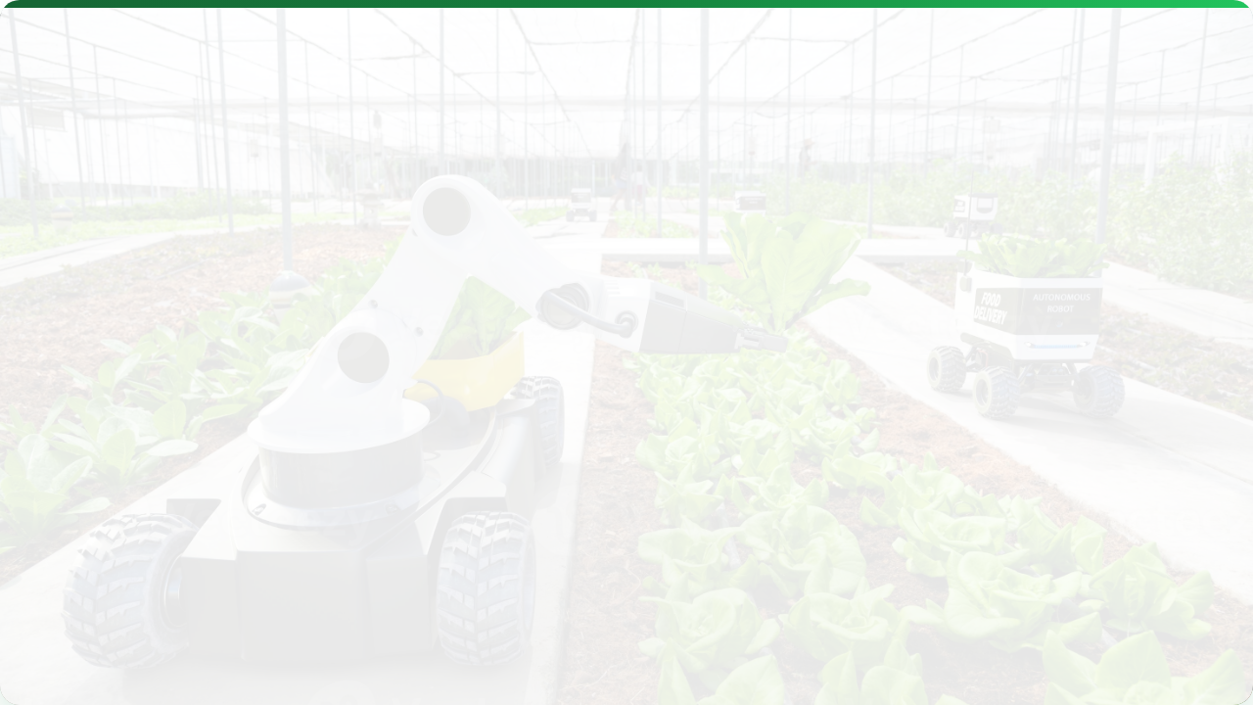



FUTURE TRENDS & CHALLENGES
Lecture 15: The Next Frontier
AGE 418
Dr. Kadeghe Fue

Slide 2




Lecture Roadmap
Emerging Trends
Challenges & Wrap-up
Edge Computing & AI
Data Security & Ownership
Blockchain Traceability
Connectivity Infrastructure
Nanotechnology
The Skills Gap
Internet of Underground Things (IoUT)
Course Summary

Slide 3

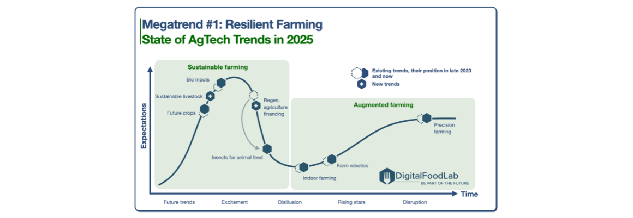
The Acceleration
Agriculture is evolving from "Mechanized" to "Digital" to "Autonomous".
We are currently at the beginning of the "Autonomous" curve.

Slide 4
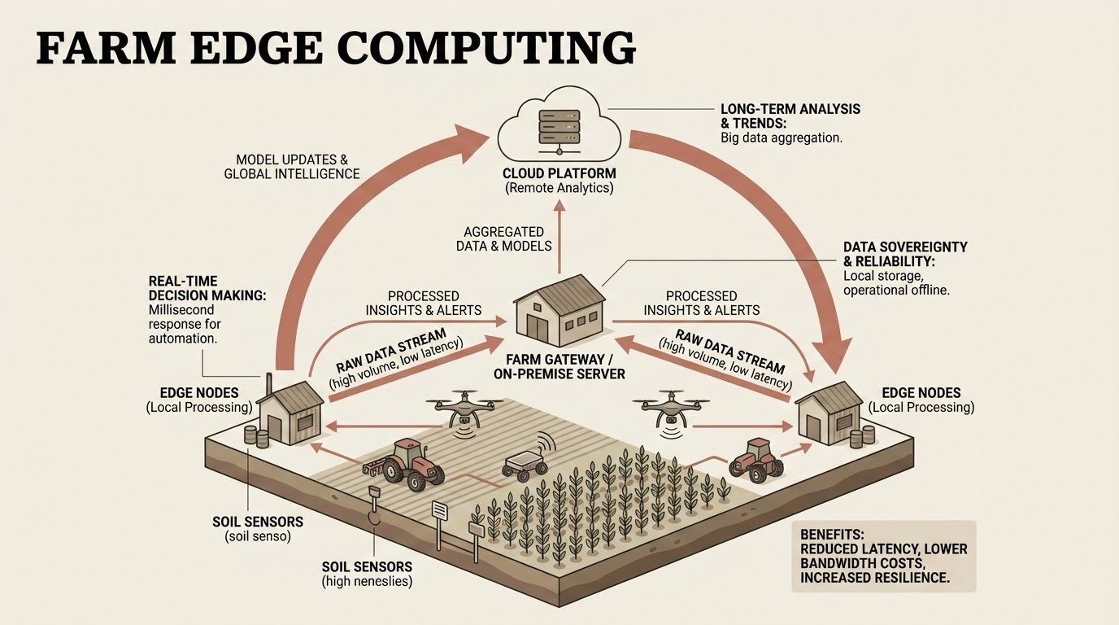
Edge Computing
Processing without the Internet.
Instead of sending video to the Cloud (slow), the tractor processes weed images locally.
Speed: Decisions in milliseconds (Spray/No-Spray).
Cost: Reduces expensive data transmission.
Reliability: Works even when the 4G signal is lost.

Slide 5

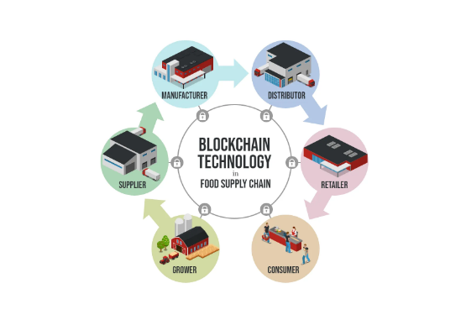
Blockchain in Ag
Trust and Traceability.
An immutable ledger recording every step of the food journey.
Consumer: Scan a QR code to see exactly which field the coffee came from and when it was harvested.
Farmer: Get paid faster through "Smart Contracts".

Slide 6
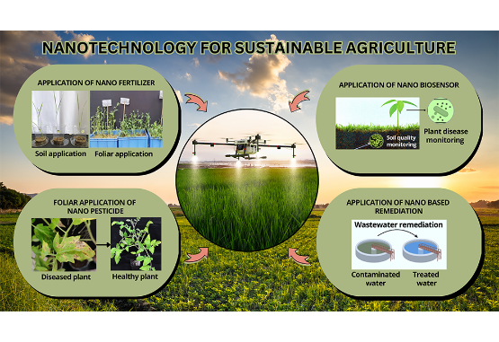
Nanotechnology
Precision at the Molecular Level.
Smart Delivery: Fertilizers coated in polymers that release nutrients only when specific chemical signals are detected from the root.
Nano-Sensors: Biodegradable sensors injected into the plant stem to report water status directly.

Slide 7
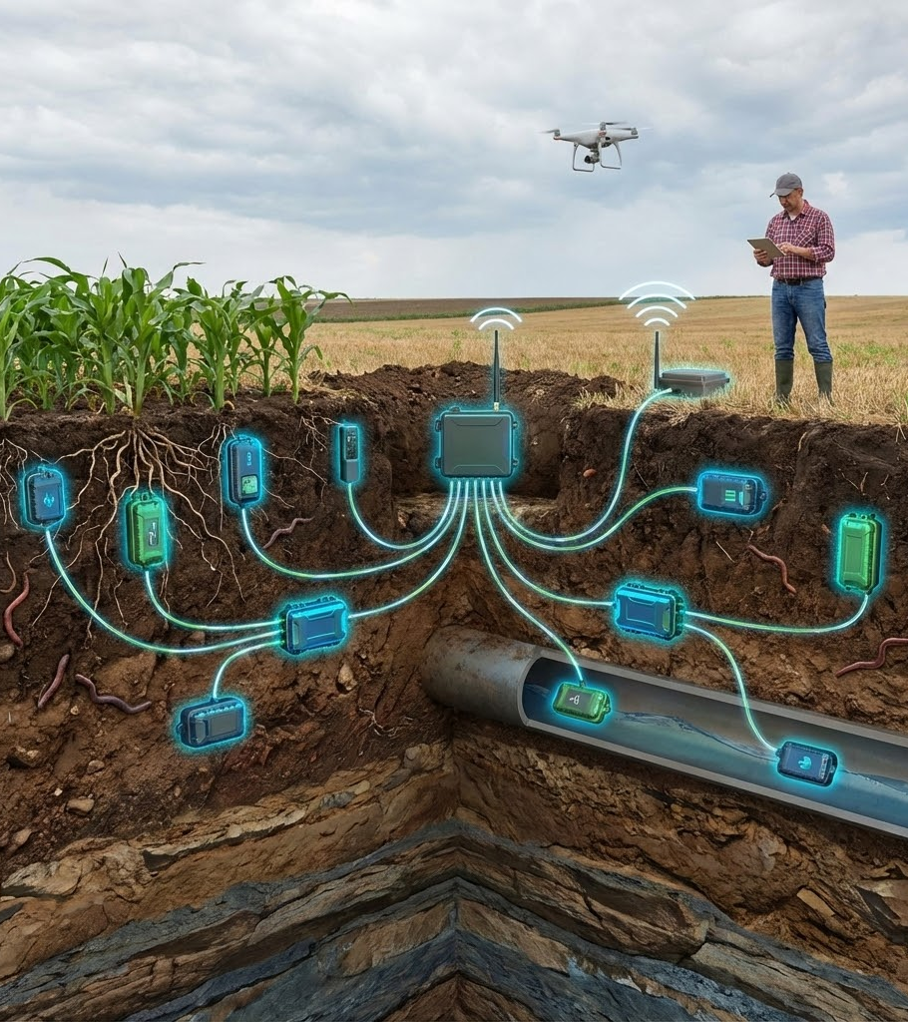
Internet of Underground Things
IoUT
Wireless sensors buried permanently in the soil.
Tech: Uses magnetic induction or low-frequency radio to transmit through the soil.
Benefit: No machinery damage (unlike sticking-up probes).
Data: Real-time root zone monitoring 24/7/365.

Slide 8
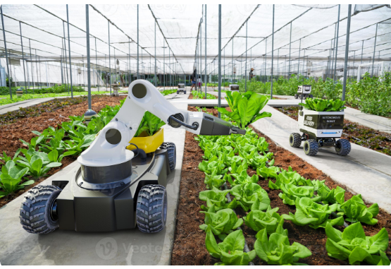
The Autonomous Farm
Hands-Free Farming.
A future where the farmer acts as a "Fleet Manager" from the office.
Small swarms of robots planting.
Drones scouting and spraying.
Autonomous carts hauling grain.

Slide 9
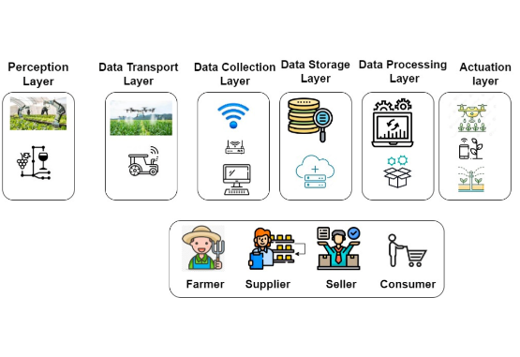
Challenge: Data Security
The Risk of Hacking.
As farms connect to the internet, they become targets.
Ransomware: Hackers locking tractors until paid.
Data Theft: Stealing yield data to manipulate market prices.
Sabotage: Remotely turning off irrigation pumps.

Slide 10
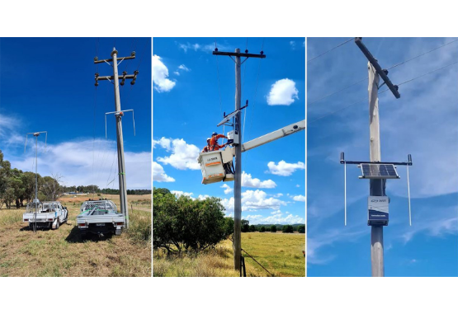
Challenge: Connectivity
The Rural Digital Divide.
Autonomous robots need high speed/low latency (5G). Most rural areas barely have 3G.
Solution: Satellite Internet (Starlink) is bridging this gap, allowing remote farms to stay connected.

Slide 11
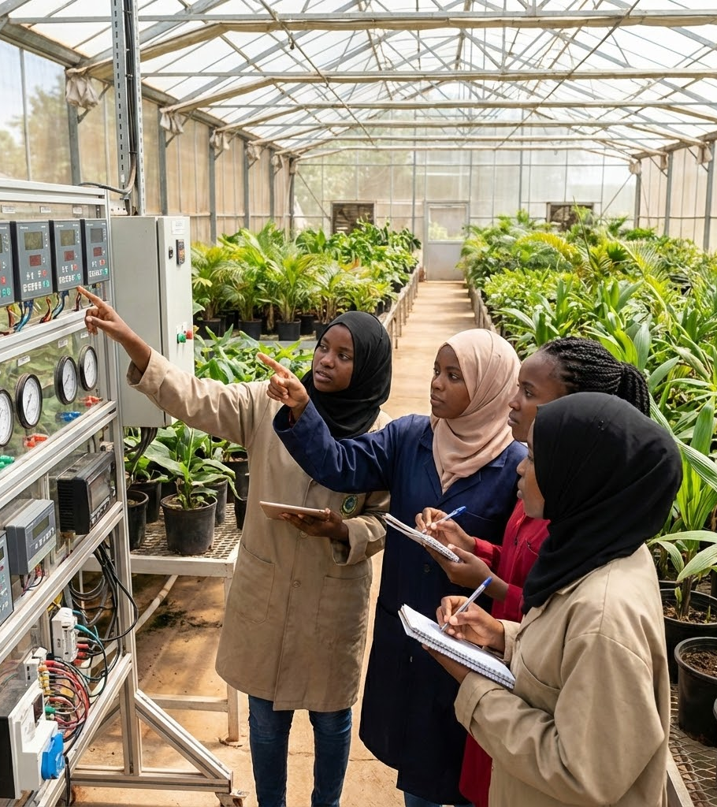
The Skills Gap
Who will fix the robot?
Modern farming requires a new set of skills beyond agronomy.
Coding & Data Analytics.
Electronics & Mechatronics.
Action: Universities (like SUA) must train "Ag Technologists".

Slide 12


Challenge: Cost vs Scale
Is PA only for the rich?
The Problem
The Solution
High-tech gear is expensive. Smallholders (2 acres) cannot afford a $500,000 tractor.
Service Economy: "Uber for Tractors". Hiring technology as a service (Drone sprayers, Soil testing).

Slide 13




Leapfrogging
Mobile
Energy
Farming
Skip landlines -> Go straight to Mobile Payments (M-Pesa).
Skip grid power -> Go straight to Solar.
Skip heavy tractors -> Go straight to Small Smart Robots.

Slide 14

Course Recap: Part 1
Foundations
Sensors
IoT
GIS, GPS, and Remote Sensing are the pillars of data collection.
We can measure Soil (Moisture/EC) and Plants (NDVI) to detect variability.
Data must flow automatically from the field to the cloud (LoRaWAN).

Slide 15
Course Recap: Part 2
Control
Analysis
Impact
VRT and Auto-Steer allow us to act on the data with precision.
Yield Maps and DSS models help us make informed decisions.
The goal is Economic Profitability + Environmental Sustainability.

Slide 16
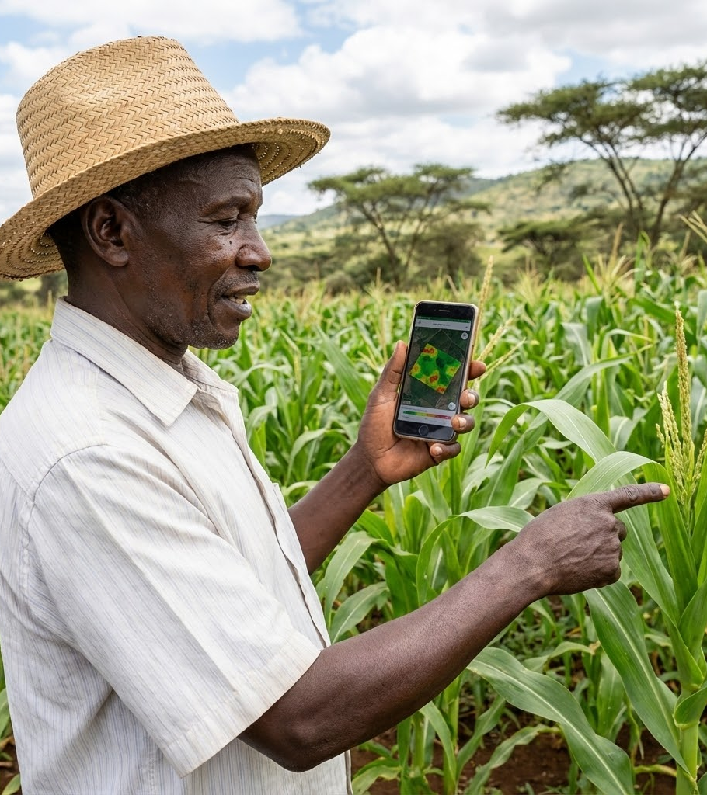
Final Thought
"Precision Agriculture is not about the technology... it is about the Management."
Sensors are just tools. The value comes from the Agronomist who interprets the data.

Slide 17

Questions?
Dr. Kadeghe Fue | AGE 418
Sokoine University of Agriculture
Good luck with your final exams!

